Slide 1
Astronomy and Light Pollution
By: Dylan Winer and Jake Kasitz
YSP Python A - Dr. Kyle Shaw

Slide 2
Introduction
What our topic is and why we chose it

Slide 3
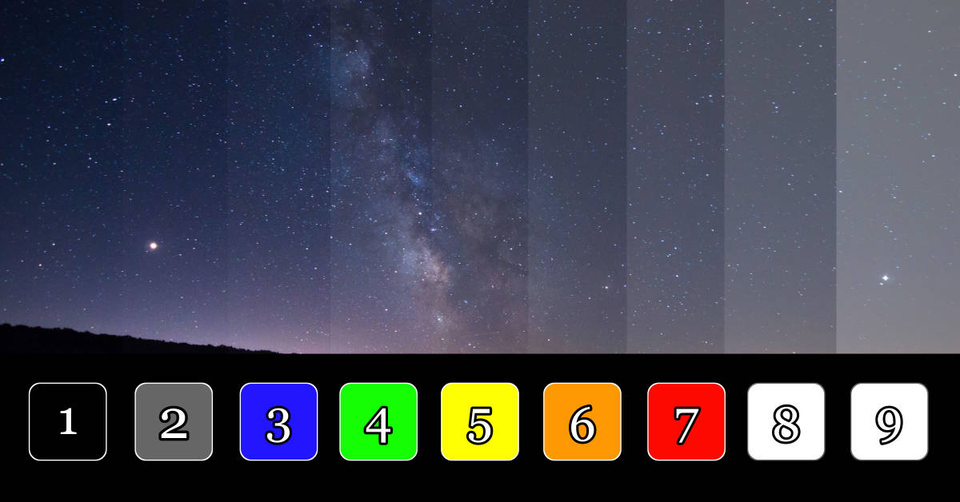
Our Topic Choice
The scientific problem we are solving is taking in images of the night sky and then quantifying the quality of the image
Determine the number of stars, constellations, and light pollution to assign a rating
Bortle Scale: method to quantify light pollution from 1-9
1 is amazing (no light pollution)
9 is atrocious (extreme light pollution)
Bortle Scale: https://nightskypix.com/bortle-scale/

Slide 4
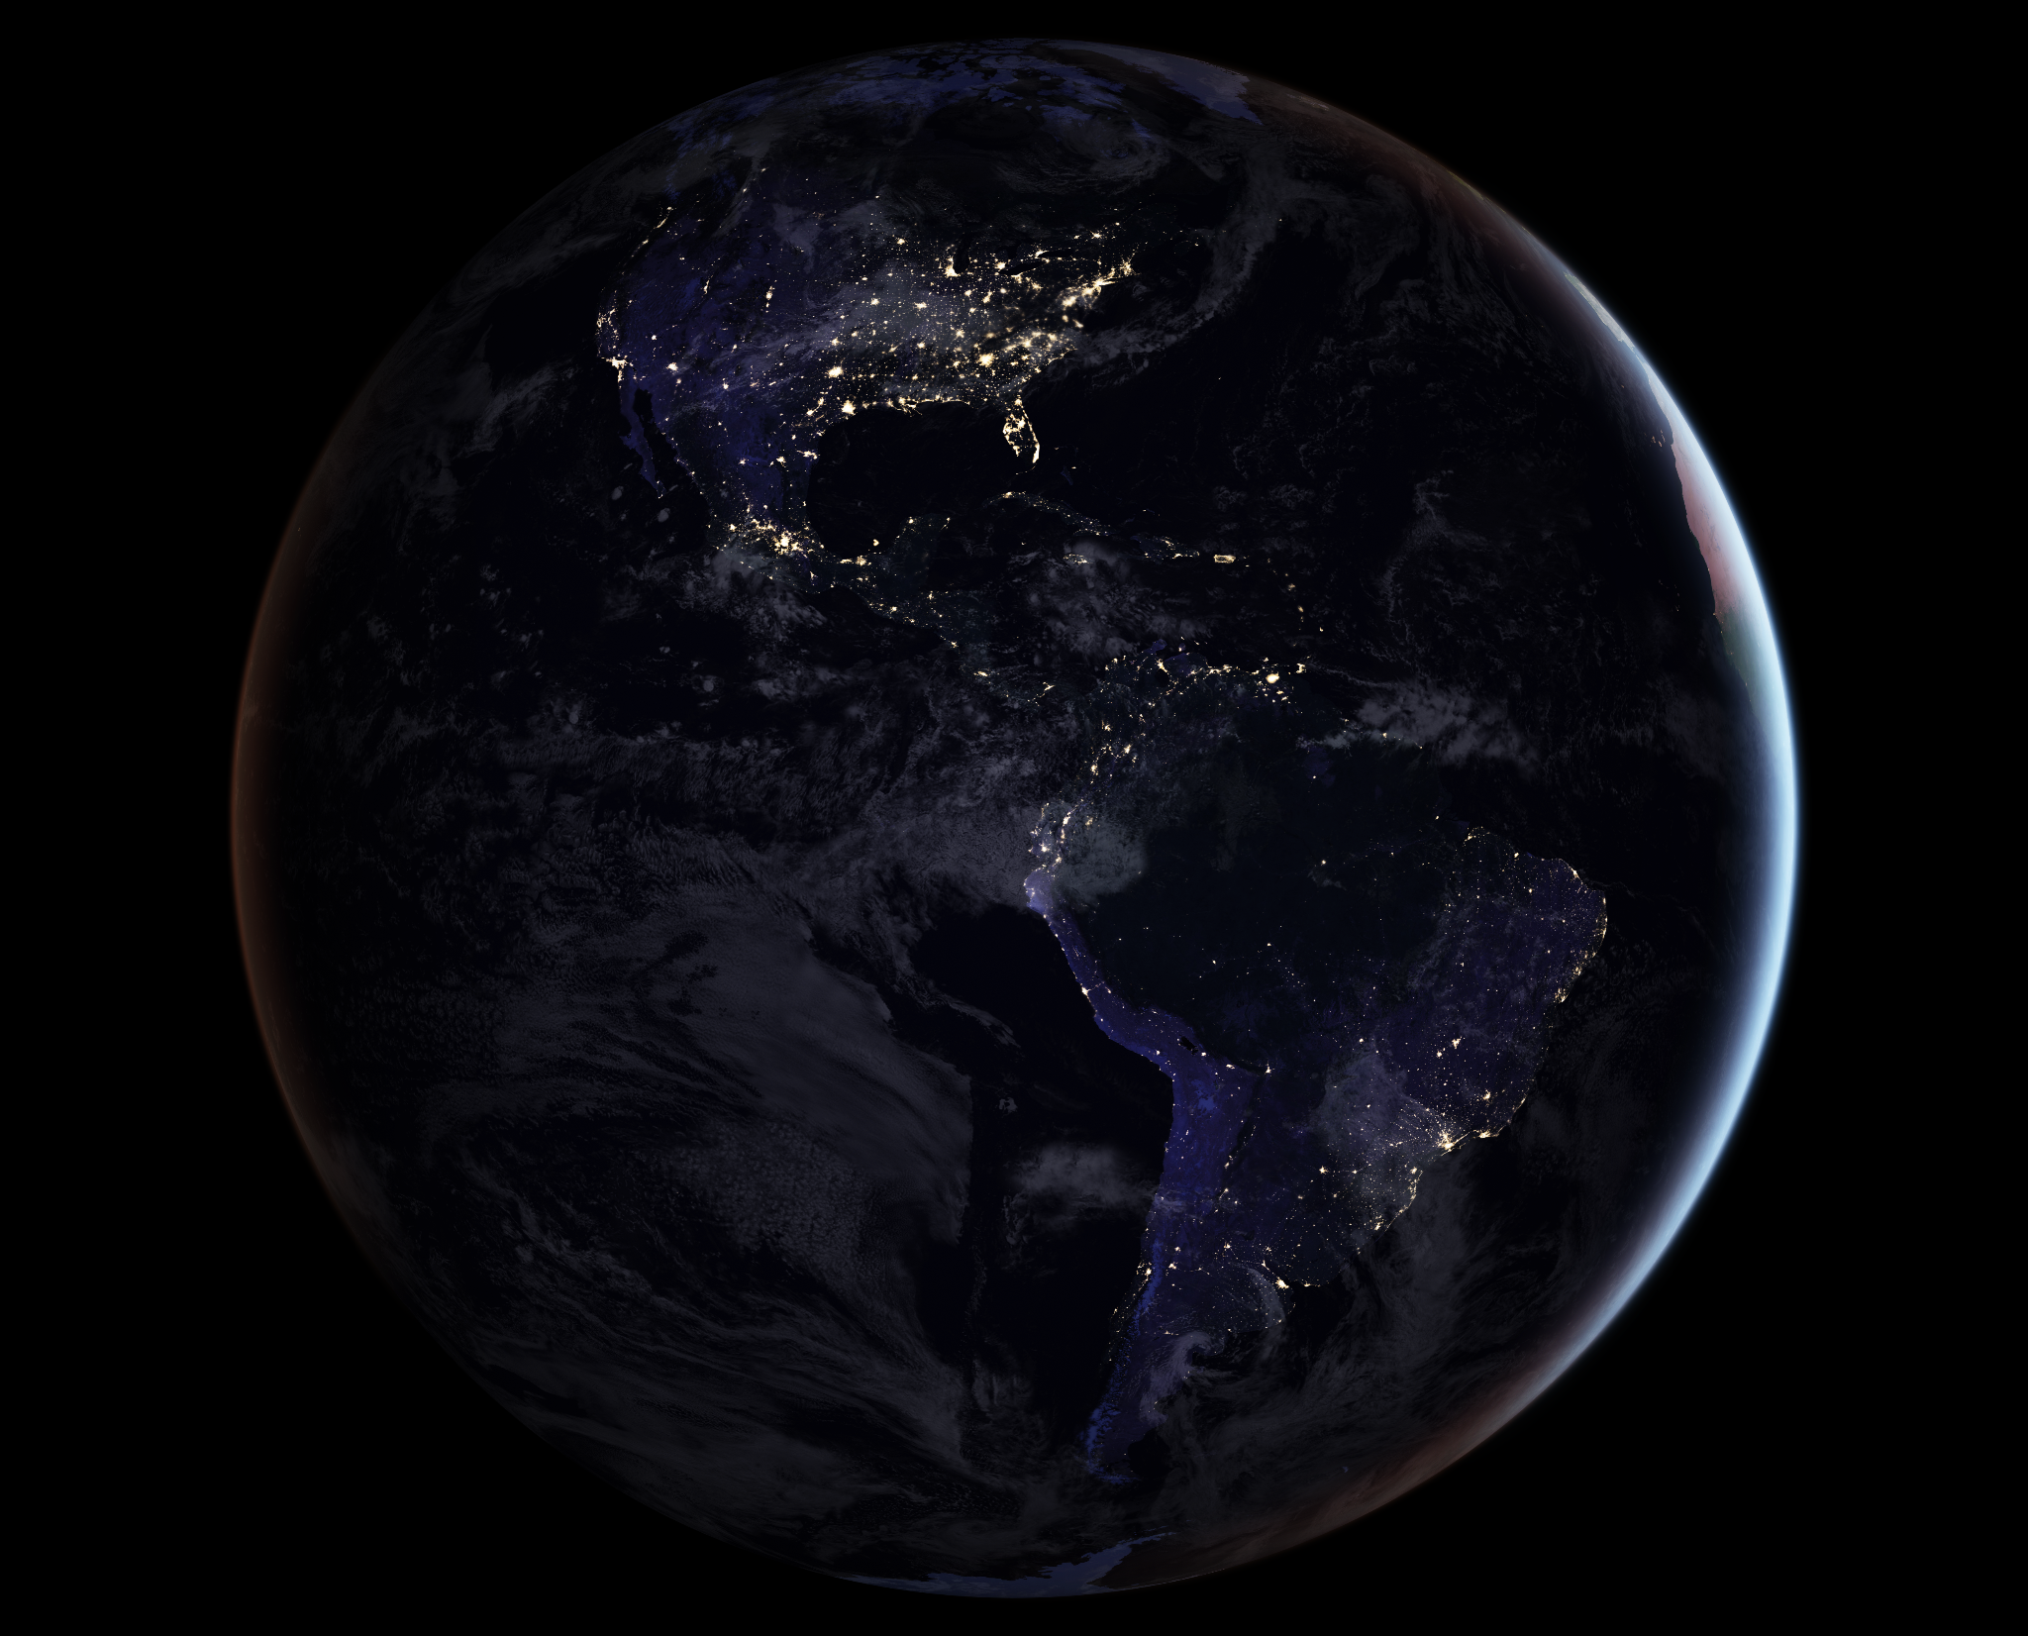
Our Topic Choice Cont.
Additionally, we wanted to output the user’s location against a map of light pollution visible from space
Shows user whether they should expect high or low visibility of the night sky
Likewise, we wanted to show the user possible constellations so they can identify them themselves
The program will then output a second scale for quality and compare to the bortle scale
https://earthobservatory.nasa.gov/features/NightLights

Slide 5
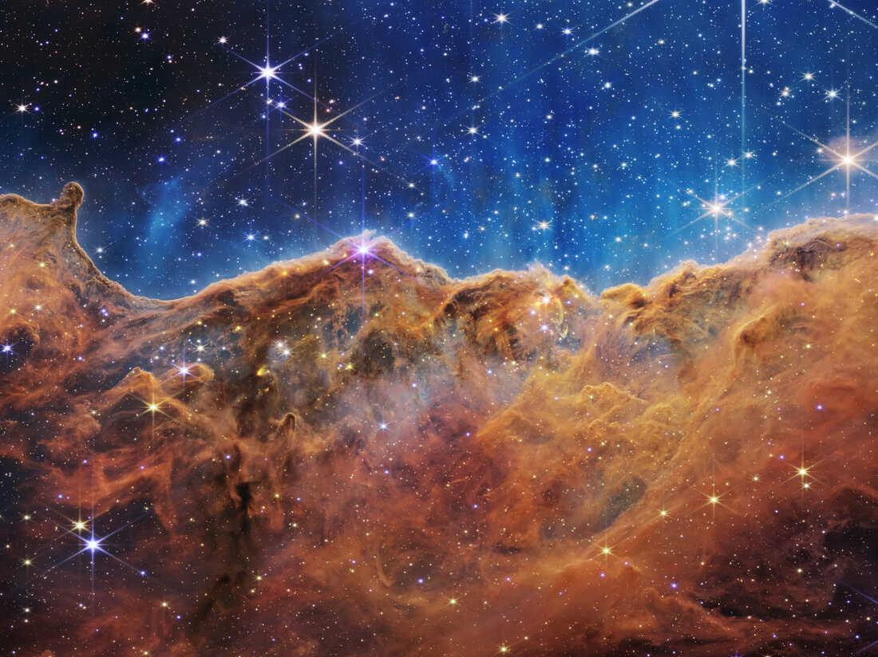
Our Topic Motivation
We chose this topic because we have always been interested in astronomy and studying the night sky
Recent images from the James Webb Telescope have also inspired us to observe the cosmos
We want to analyze light pollution and illustrate its negative impact on stargazing
The night sky is amazing to view, which light pollution unfortunately detracts from
https://www.npr.org/2022/07/17/1111714756/james-webb-telescope-big-bang-galaxy-image-interview-project-manager-bill-ochs

Slide 6
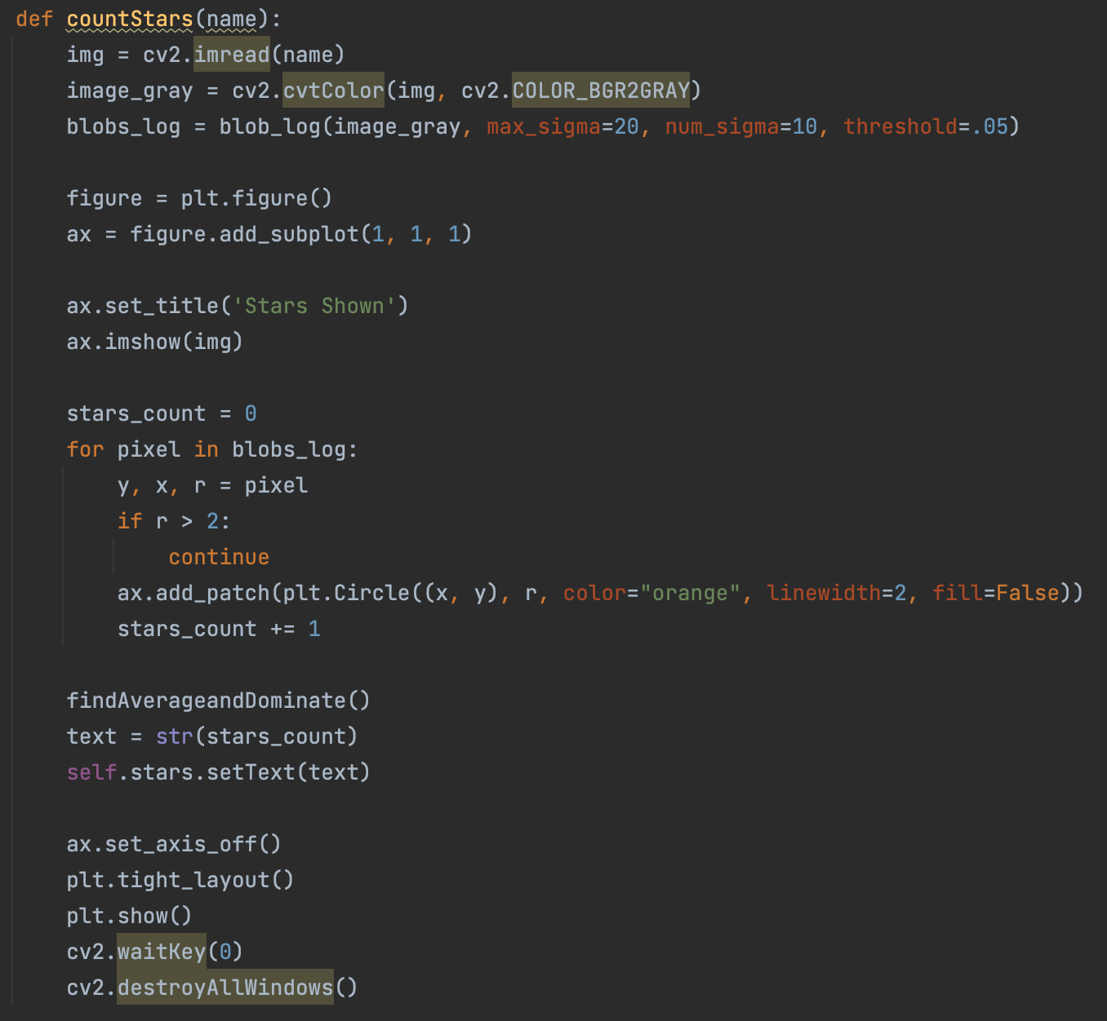
Counting Stars (not the song)
We used OpenCV to process images of stars
Image is converted to grayscale
Grayscale gets plotted
Iterate through pixels if radius smaller than 2, add pixel patch to total stars
From there we used a blob detection function from OpenCV to detect the bright stars from from the darker sky
Output second plot with circles highlighted

Slide 7
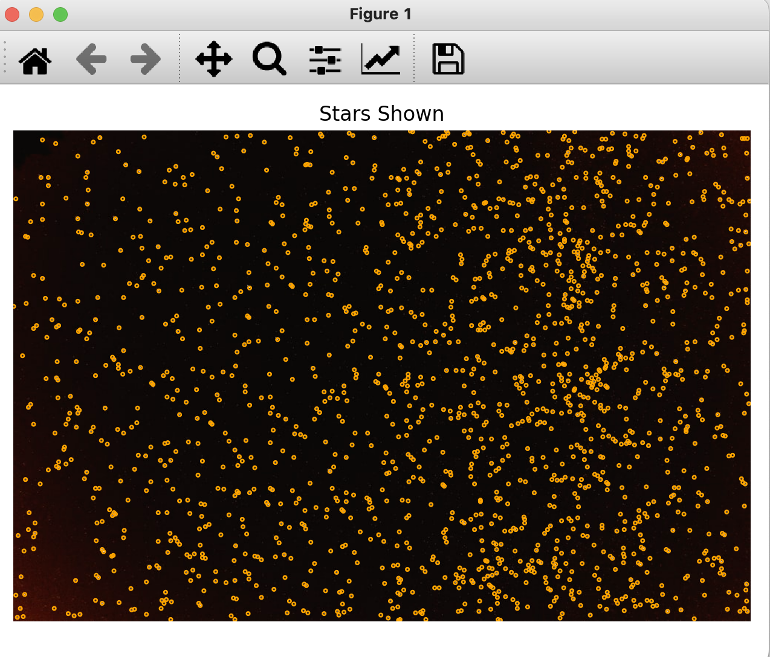
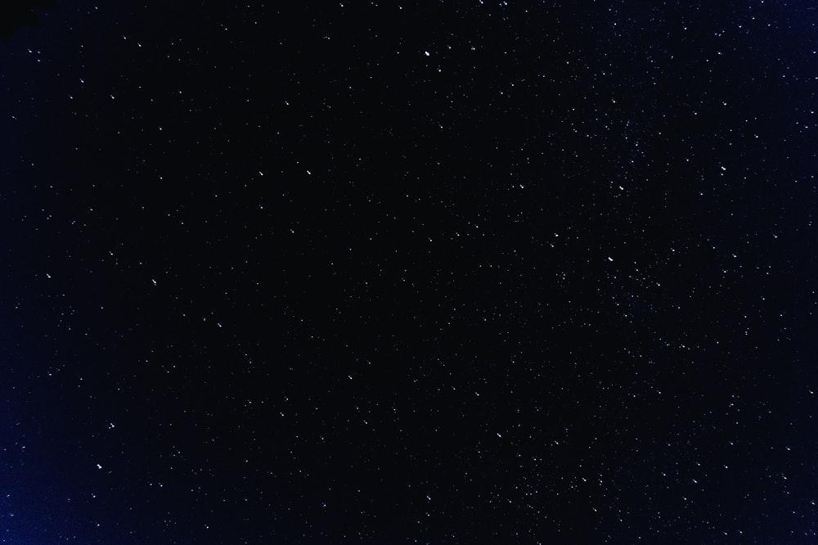
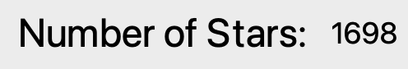
Counting Stars Output
Original Image
Output

Slide 8
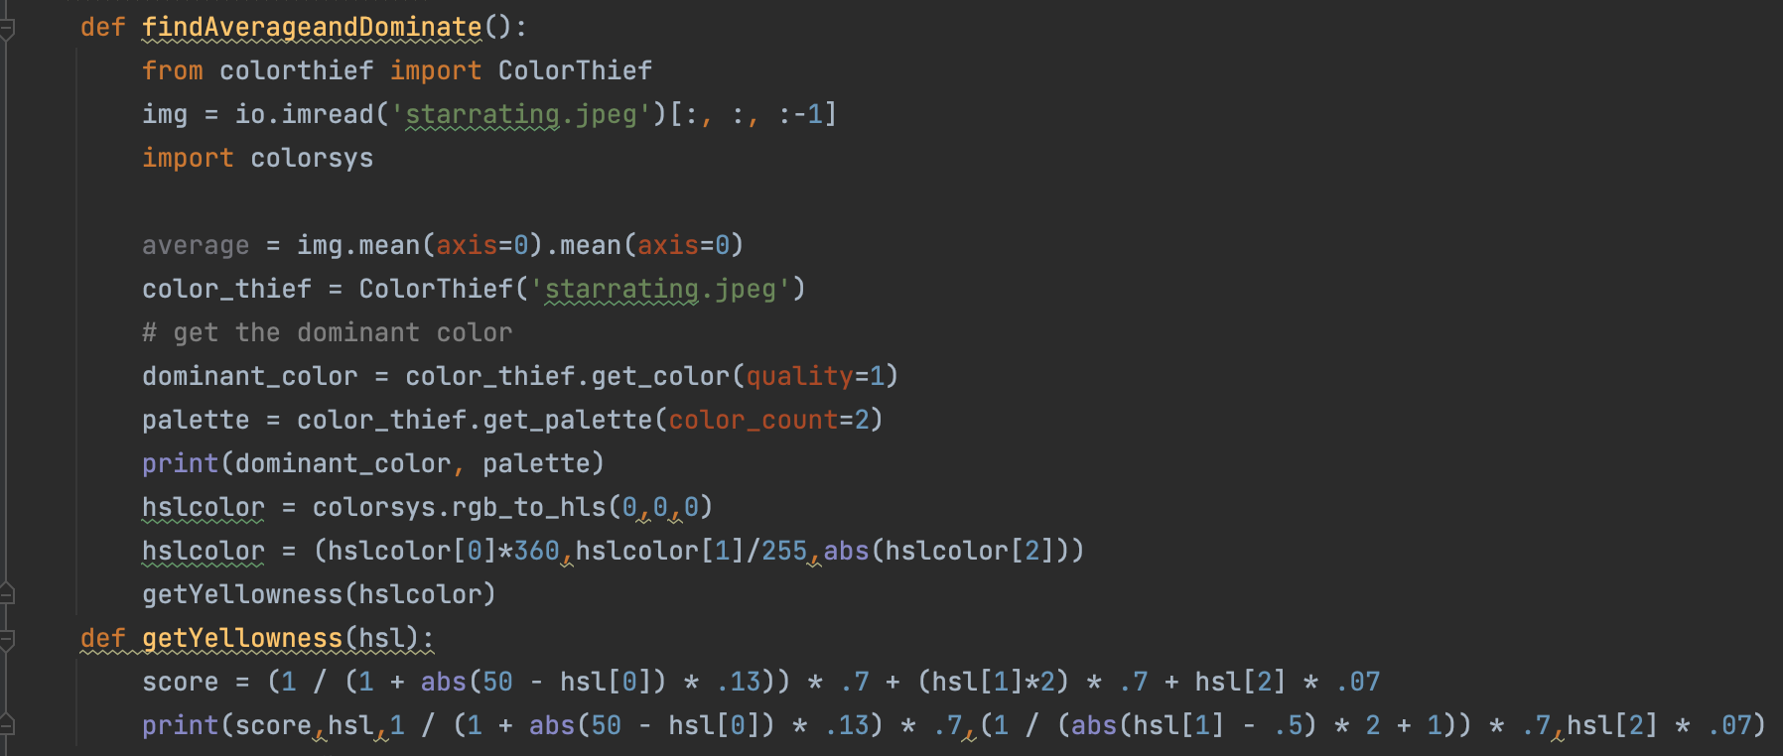
Detecting Light Pollution
We take the stars detected and remove them from the image
Then we take an average value of the color of the sky
We then find this score
From that average color, we compute the score of light population based on brightness and hue
If the color is closer to a yellow hue, the score increases
Same if the color is brighter

Slide 9
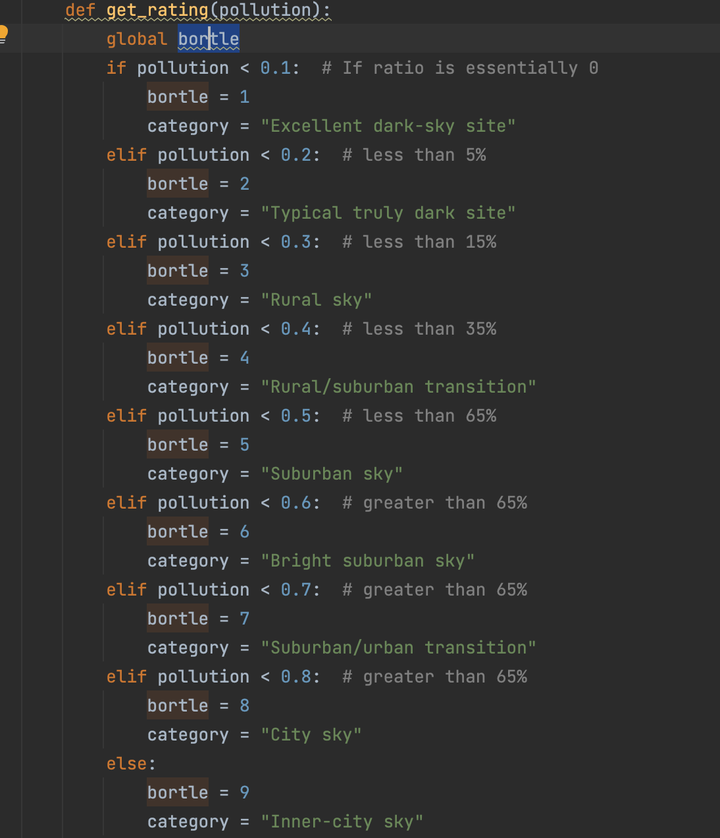
Rating Light Pollution
We then take this score and calculate a bortle rating
Bortle rating of 1 = excellent
Bortle rating of 9 = urban-city light pollution
Ratio of pixels with light pollution compared to total pixels determines bortle rating
Also output a category like excellent site or rural sky depending on rating

Slide 10
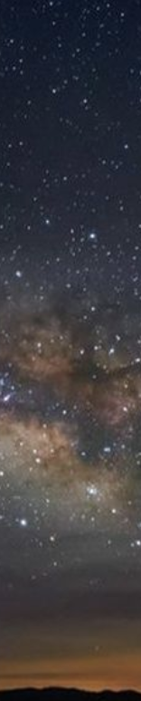
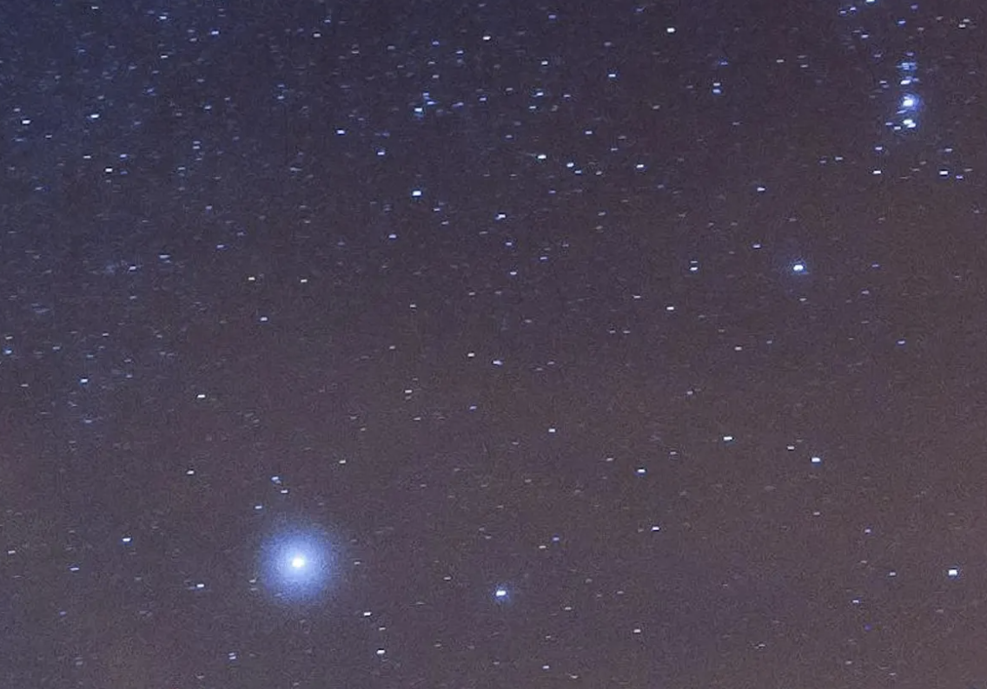
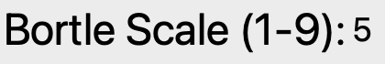
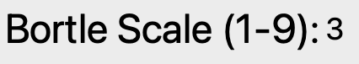
Rating Light Pollution Output
https://www.theguardian.com/science/2019/apr/17/not-so-starry-night-light-pollution-spoils-the-view-for-stargazers
https://suburbanastro.com/astrophotography/bortle-scale-light-pollution/

Slide 11
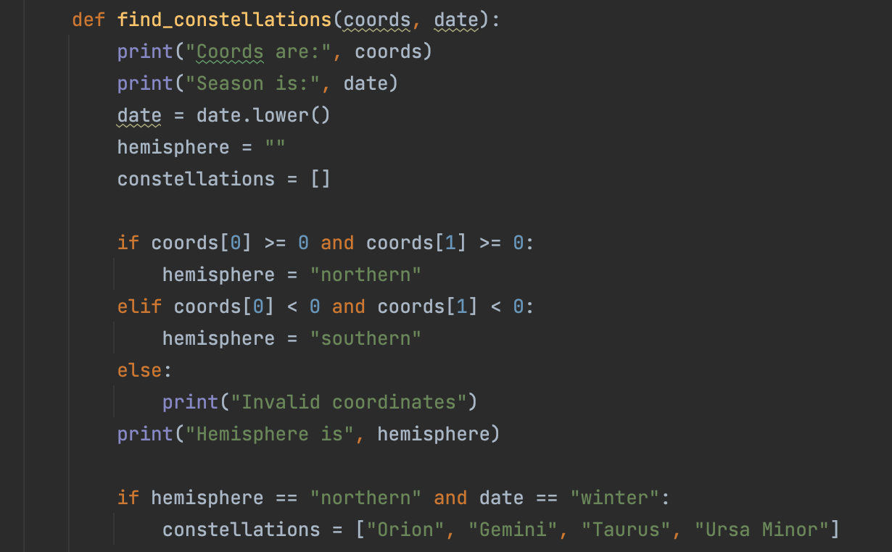
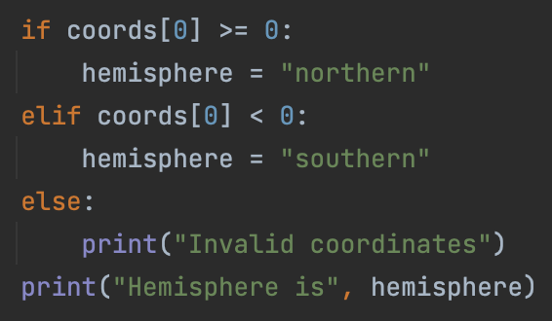
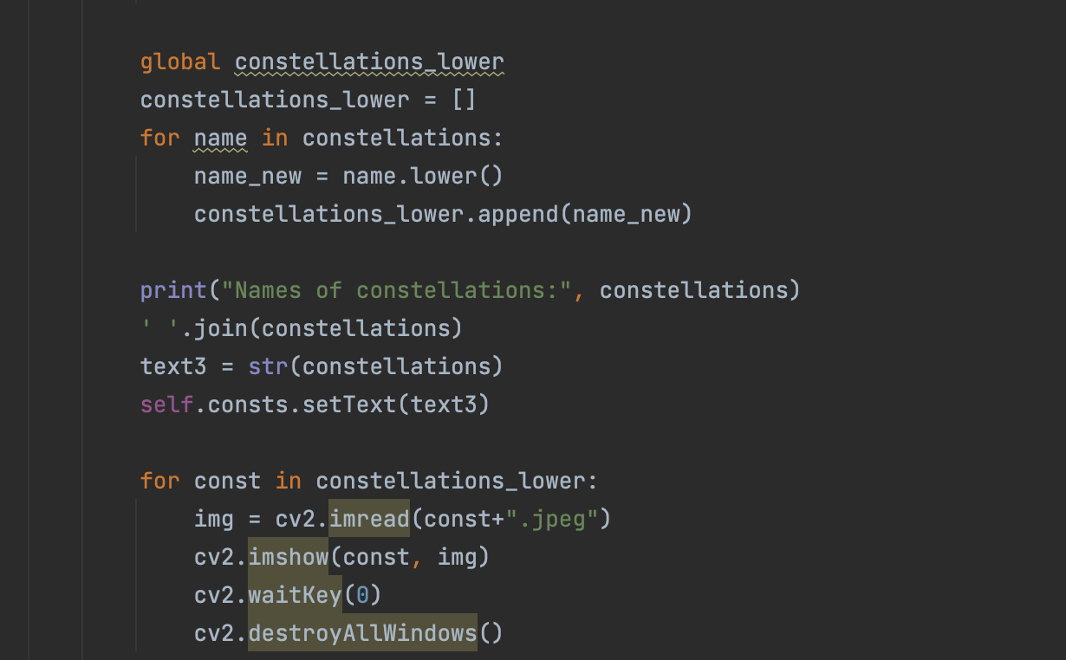
Constellations
We ask the user for their longitude, latitude, and season
Positive coordinates mean northern hemisphere
Negative coordinates mean southern hemisphere
Constellations visible change depending on season and hemisphere
Based on these attributes, we tell the user what constellations they might be able to see.

Slide 12
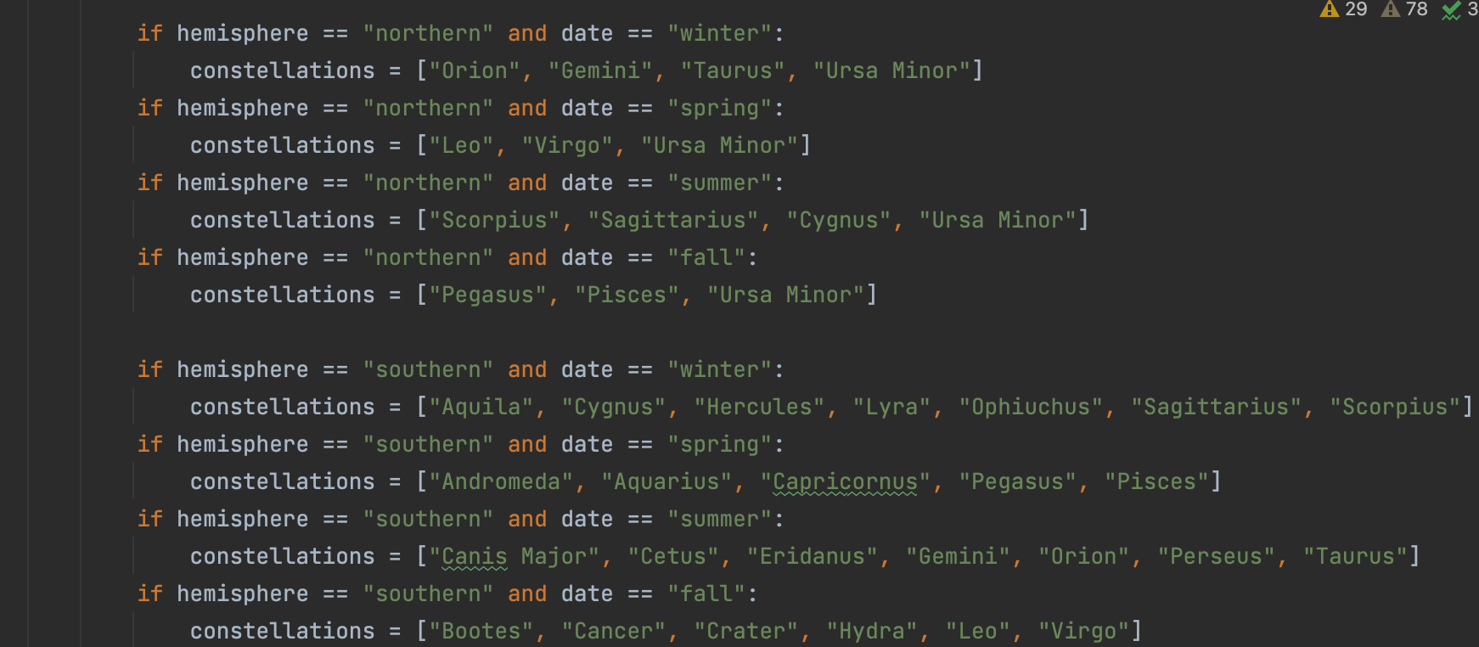
Constellations Continued
Possible combinations of northern or southern hemispheres combined with seasons provide below lists:

Slide 13
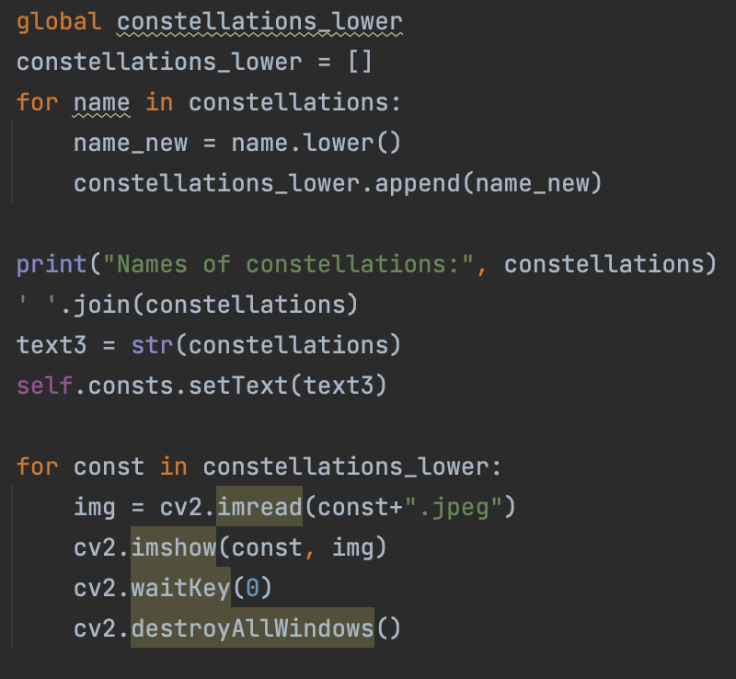
Constellations Analyzed
We also output the constellations to the user, and they can input which of the constellations they see

Slide 14
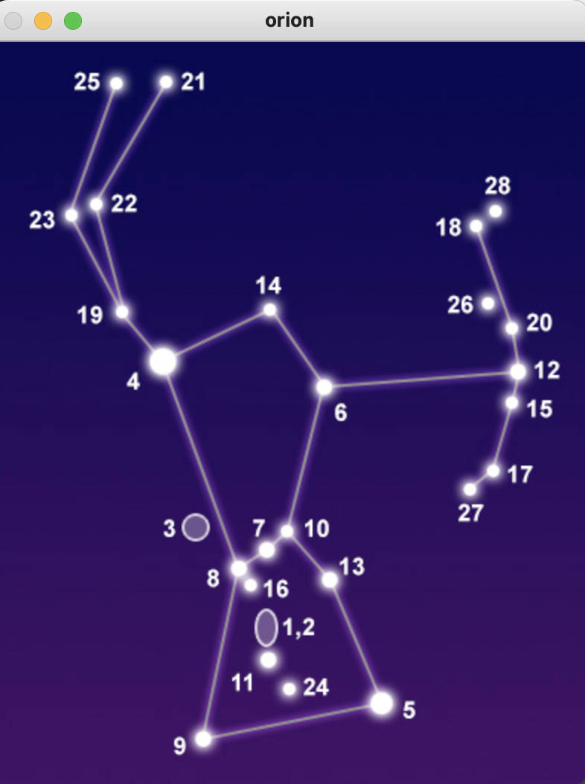
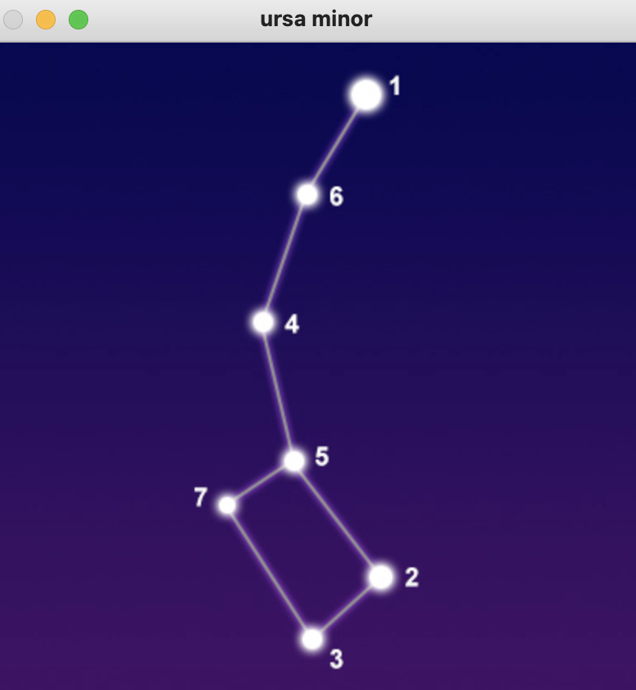
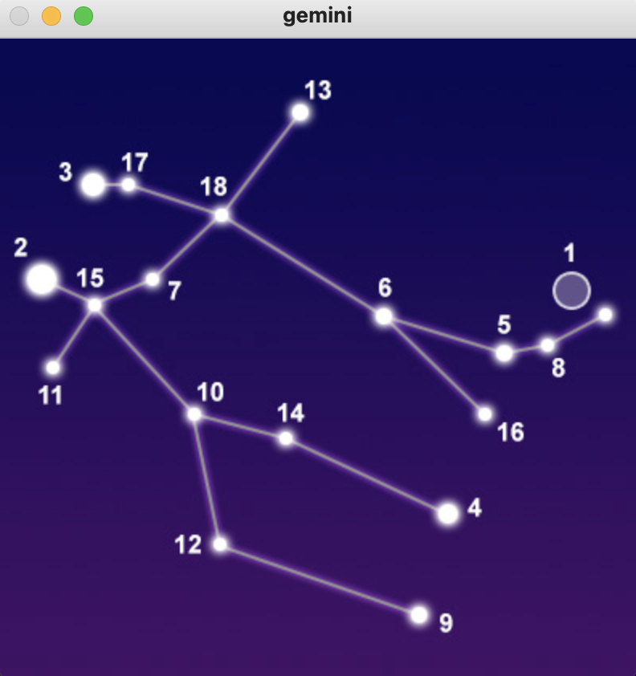
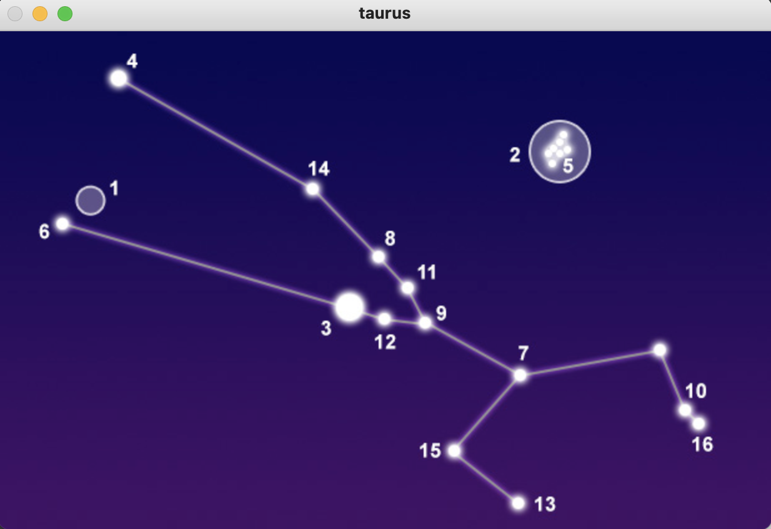
Constellations Analyzed Cont.
Example for northern hemisphere and winter:
Taurus
Orion
Ursa Minor
Gemini

Slide 15
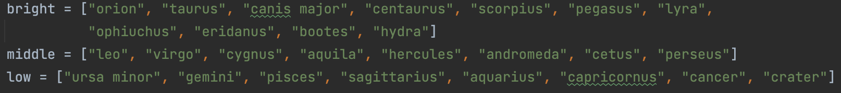
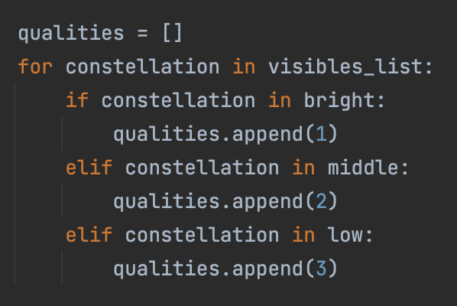
Constellations Analyzed Cont.
We then sorted constellations into bright, middle, and low groups based on online listings
Iterate through to find dimmest constellation visible, which shows a higher quality, as dim constellations are harder to see
Maximum difficulty to see is quality value kept

Slide 16
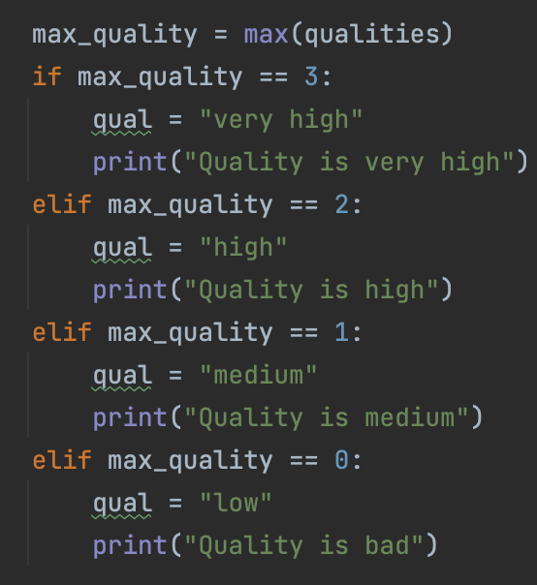
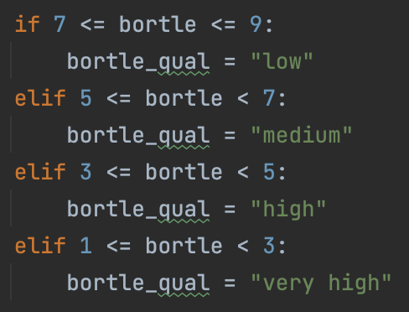
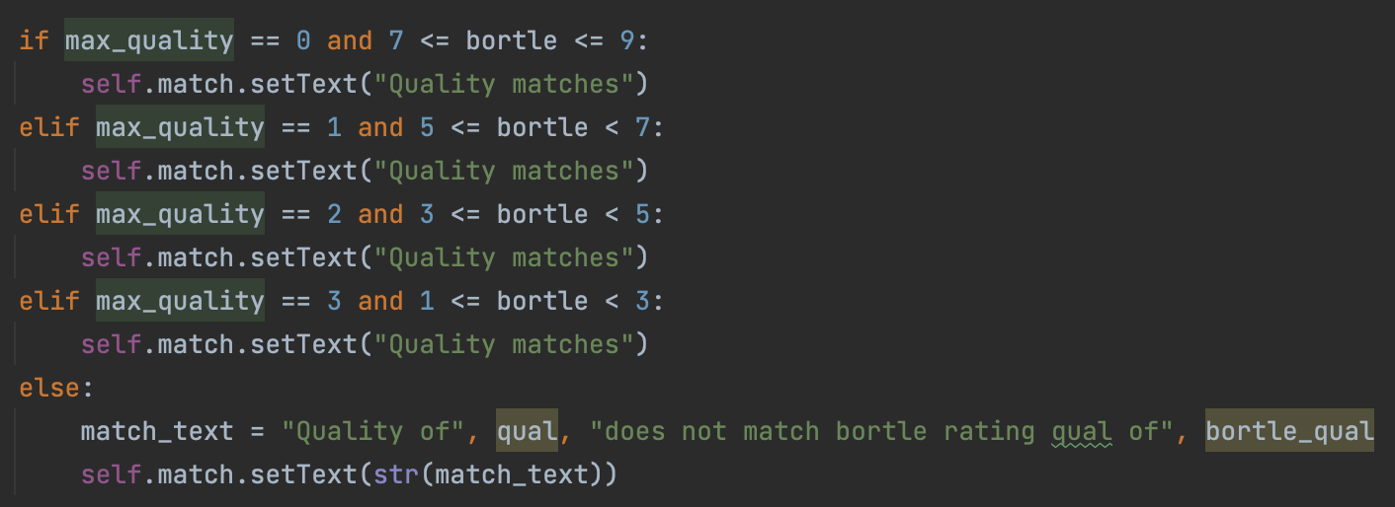
Constellations Analyzed Cont.
Determine quality based on constellation
Compare that quality to bortle quality, and see if they match
Output whether they match back to user

Slide 17
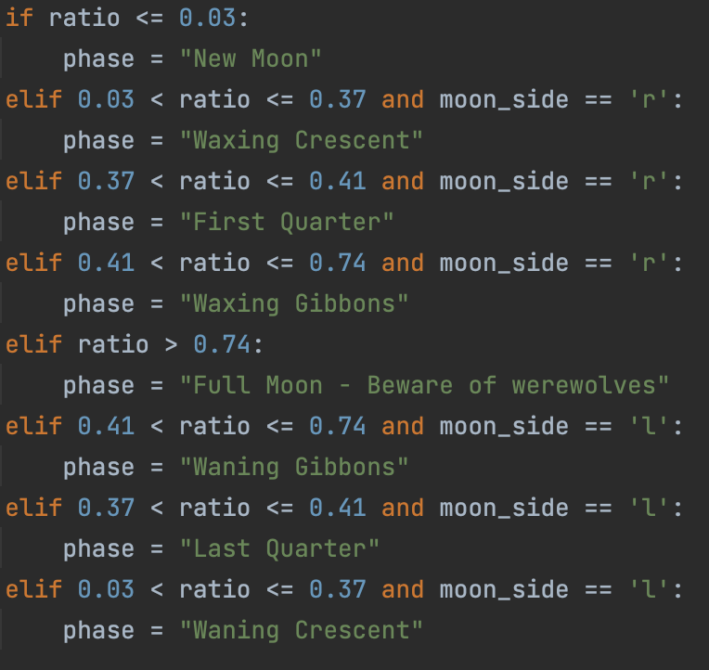
Moon
Allow the user to crop the image into a rectangle with the edges of the moon bordering the rectangle
Convert image to black and white, and use ratio of black and white pixels to assign a phase
Also take input of whether left or right side is visible to assign a phase

Slide 18
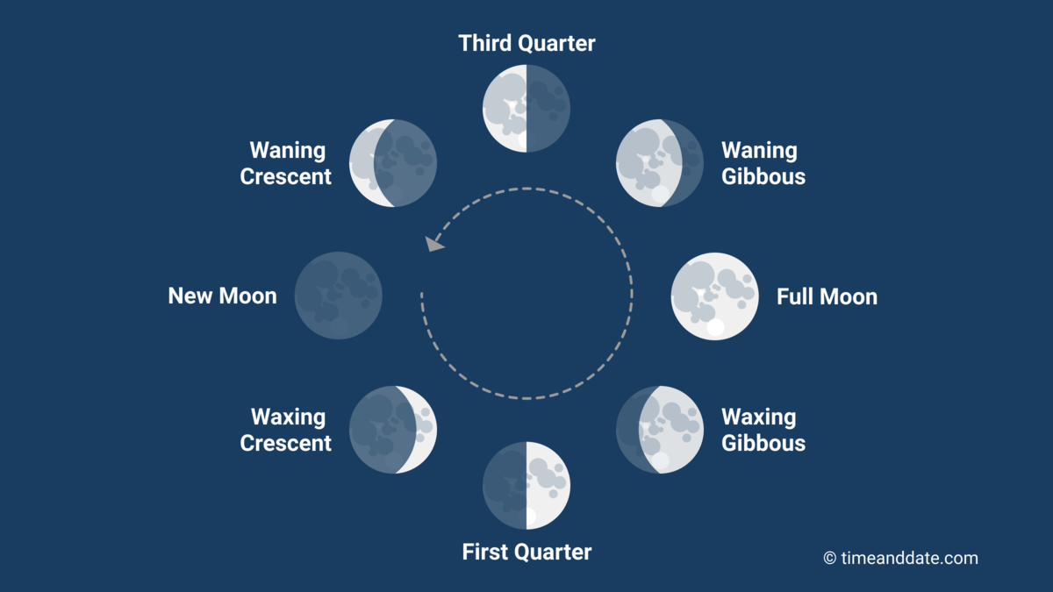
Moon Phases
https://www.timeanddate.com/astronomy/moon/phases.html

Slide 19
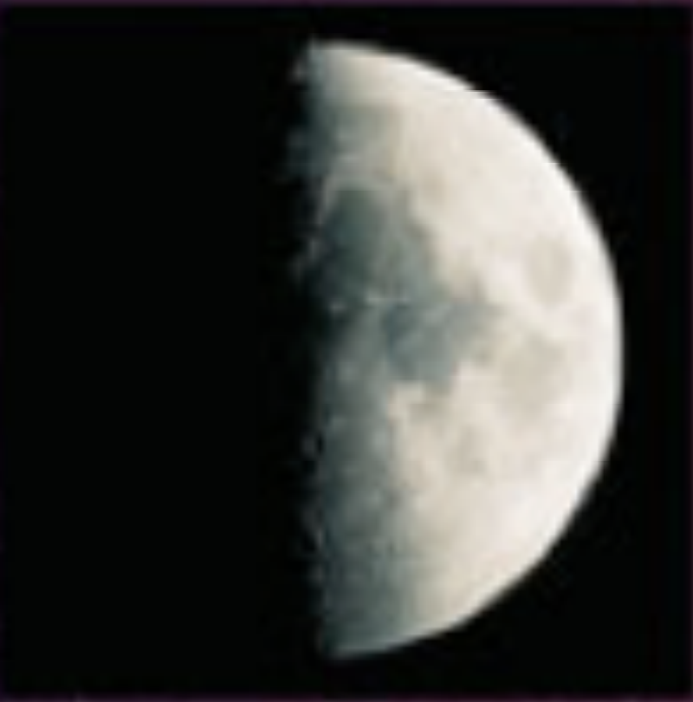
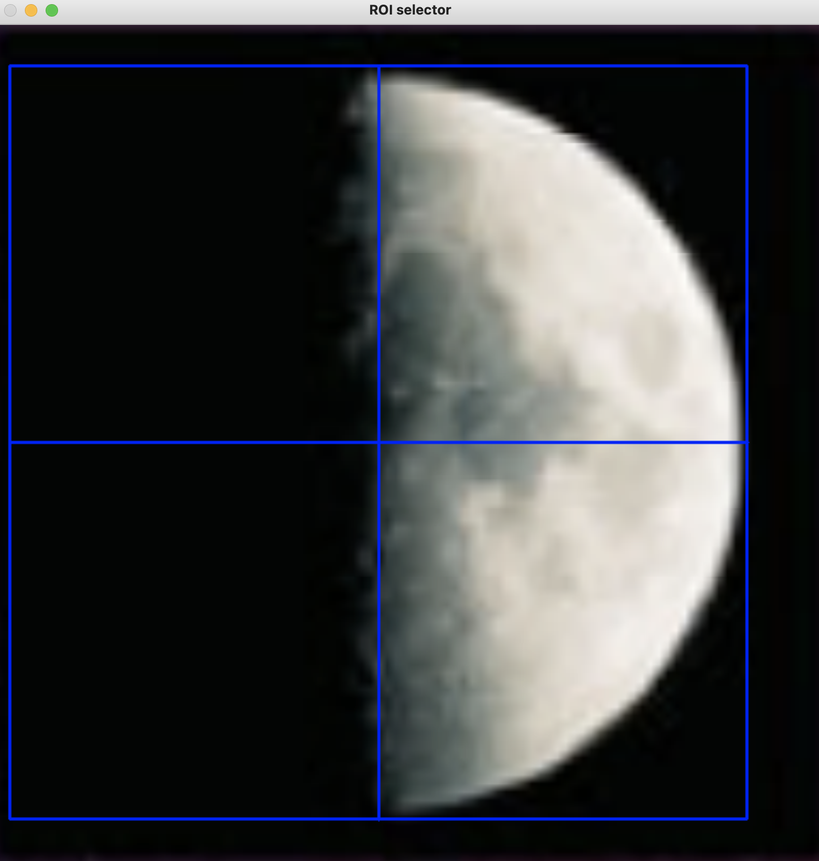
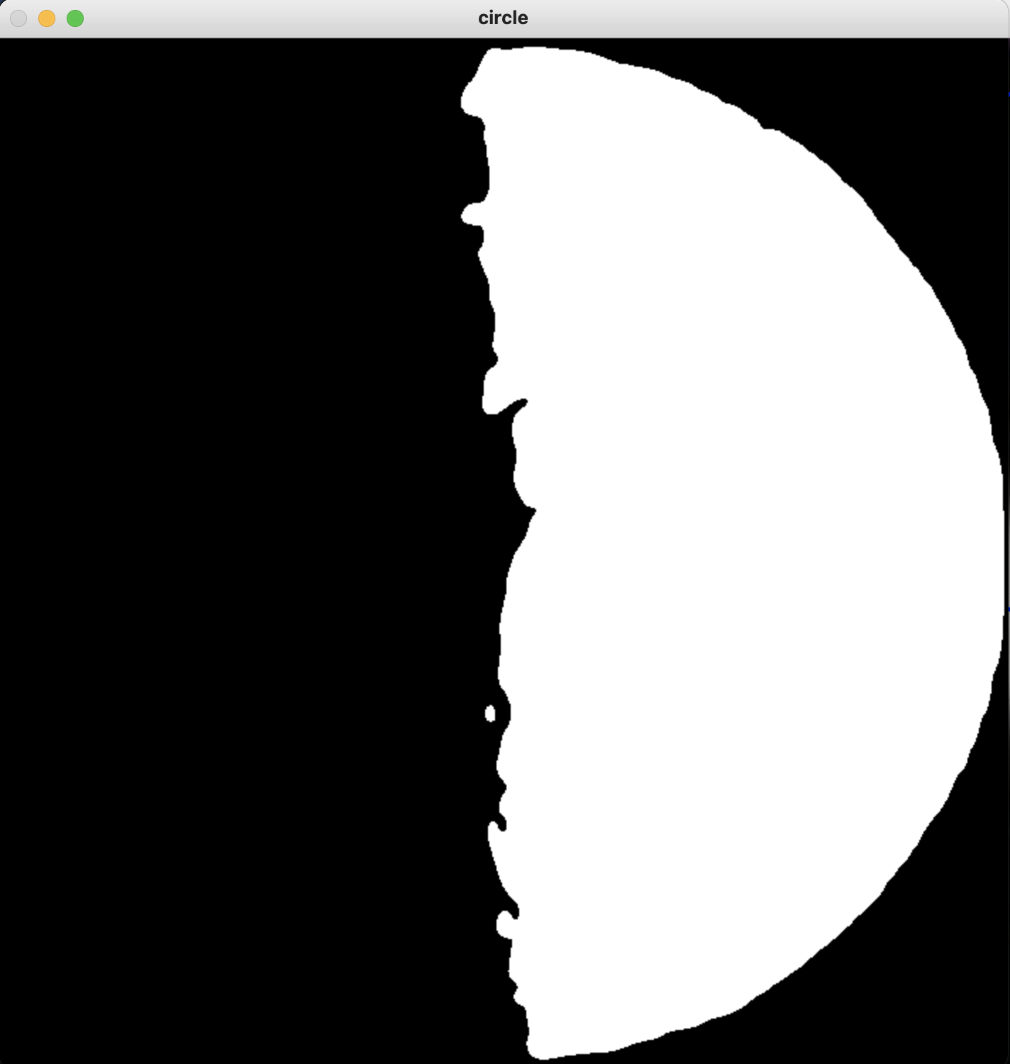
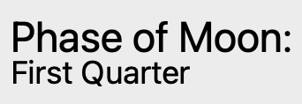
Moon Visualized
Input Image
Crop Moon

Slide 20
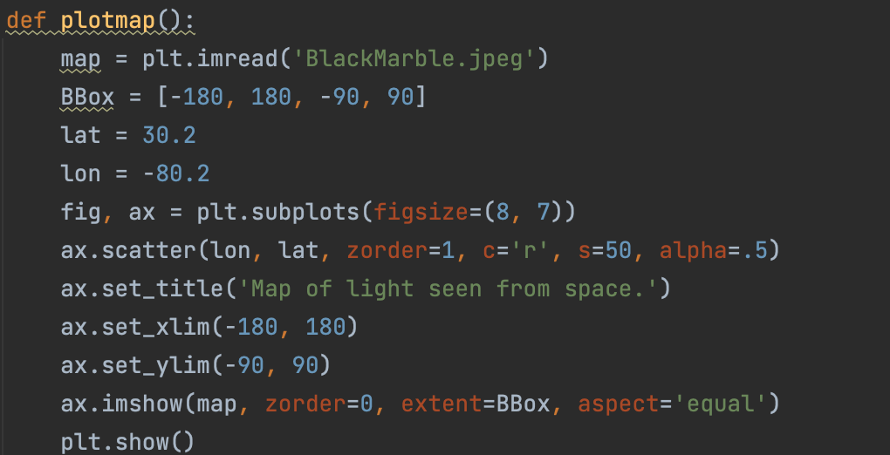
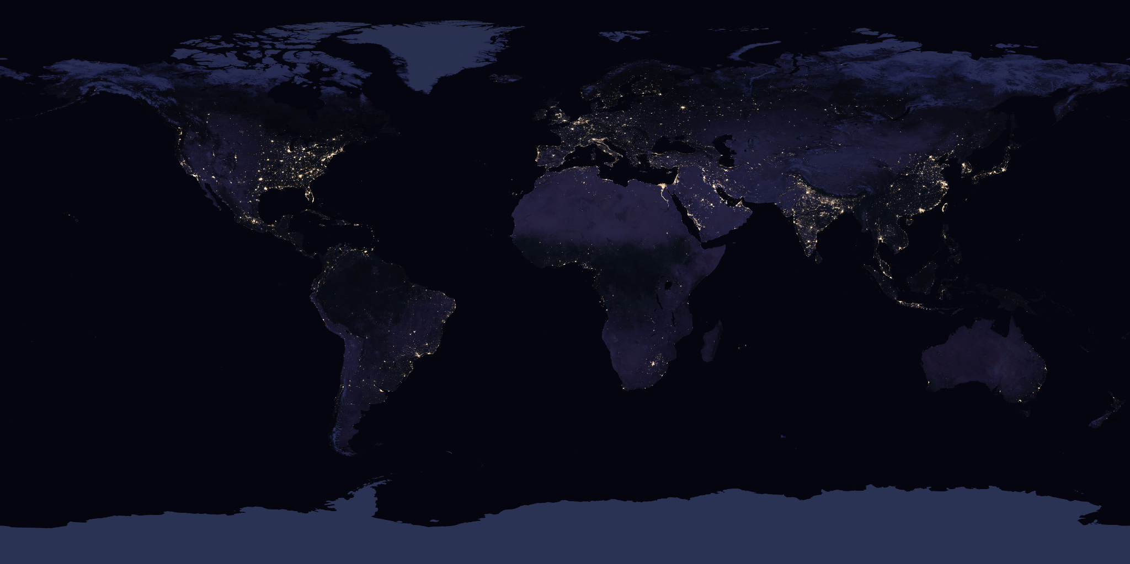
Map
Using the longitude and latitude the user gave earlier, we can plot that point on a map.
We use NASA’s Black Marble to show how city lights are seen from space.
Bright spots of the map will have more light pollution.

Slide 21
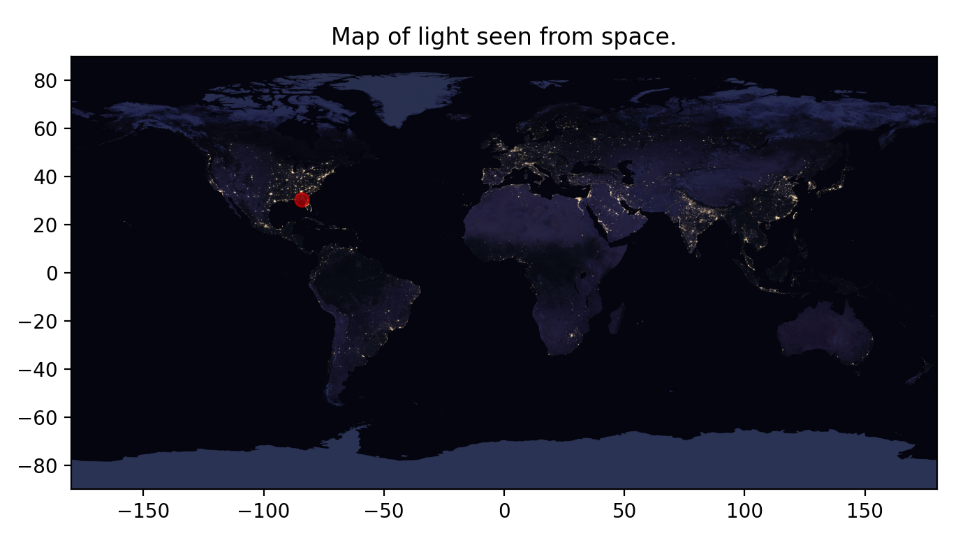
Map Visualized
FSU’s Coordinates
30.4419° N, 84.2985° W (-)

Slide 22
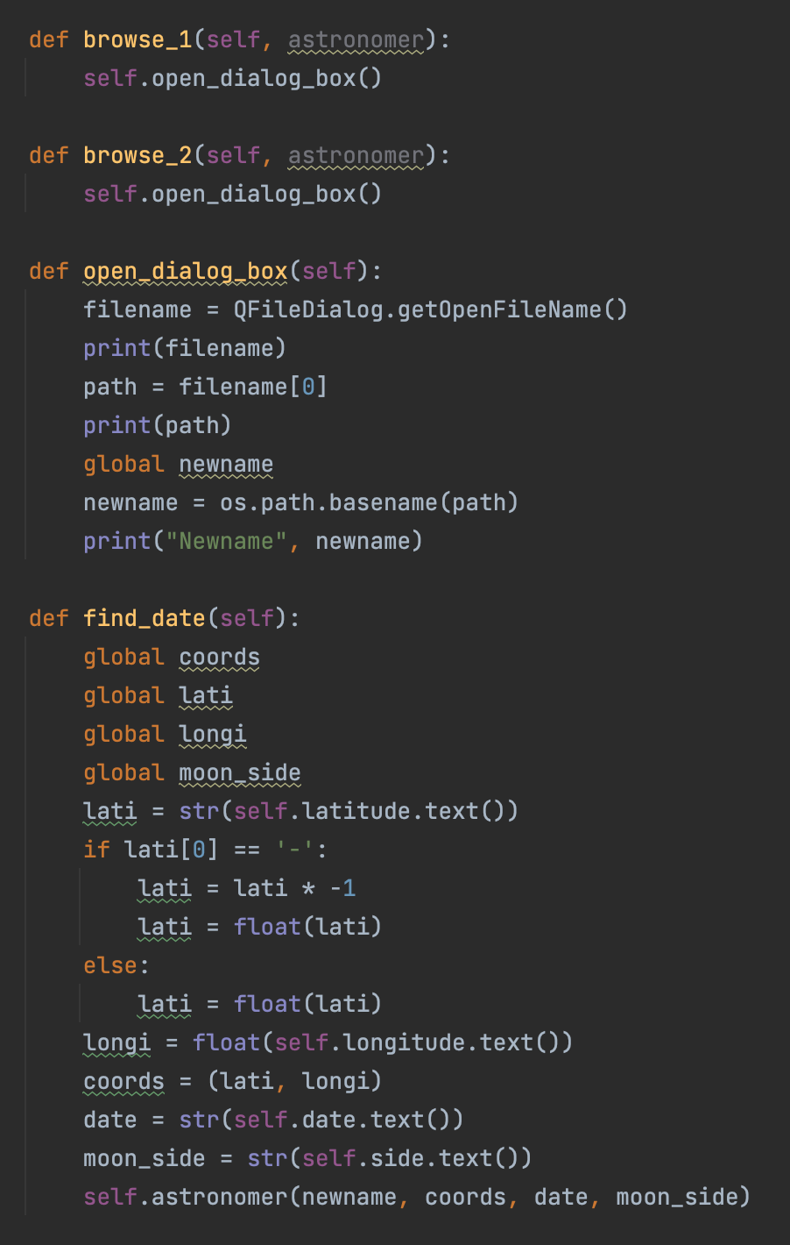
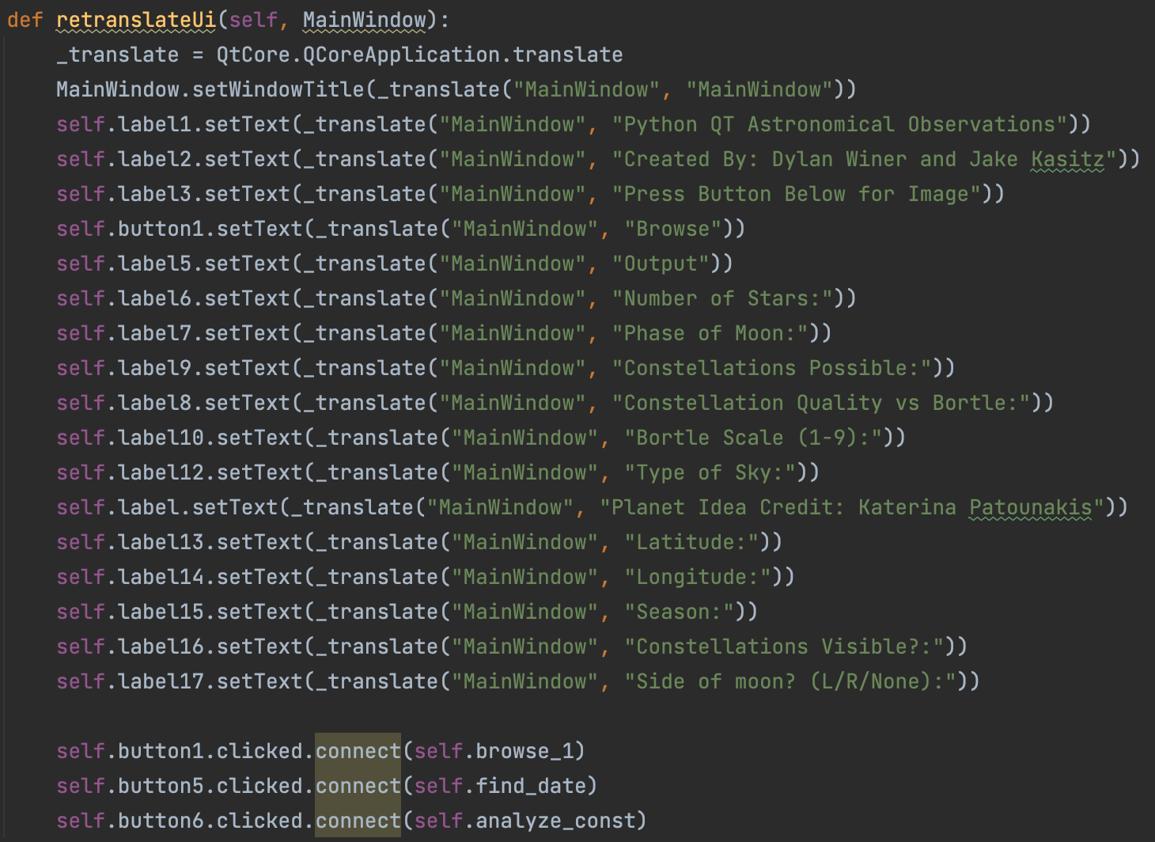
GUI Code

Slide 23
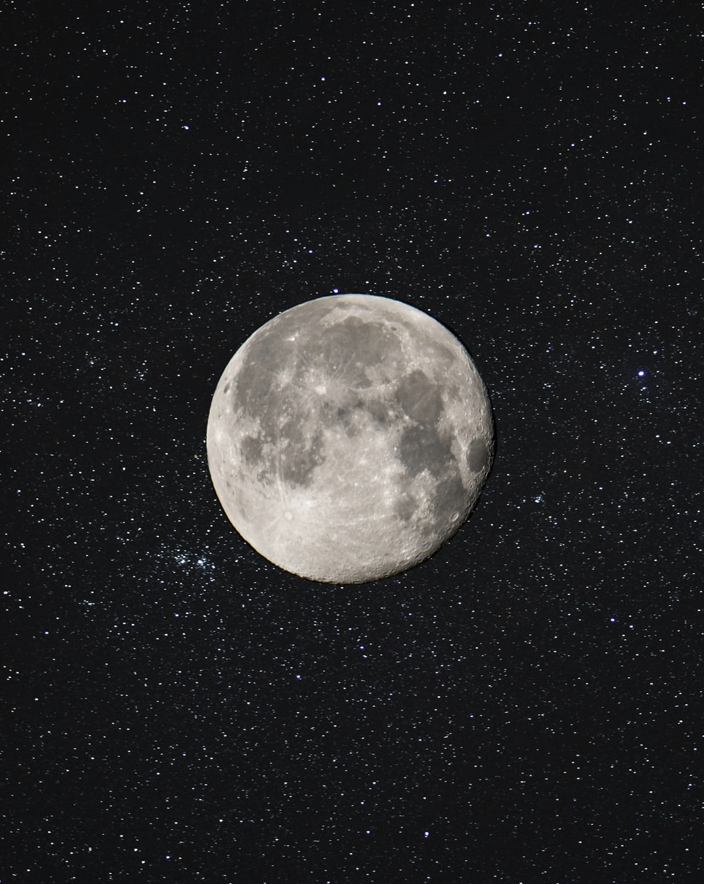
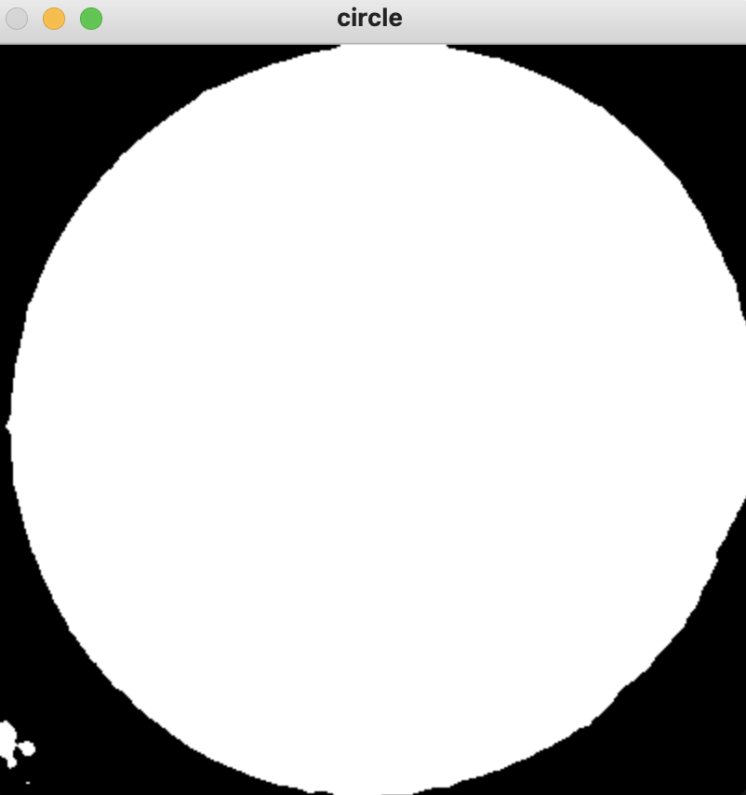
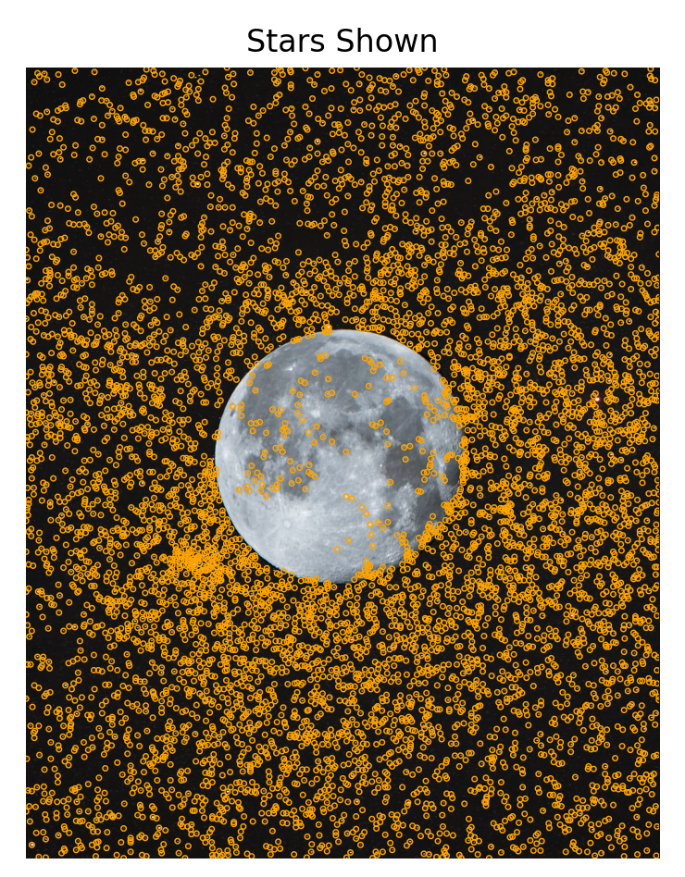
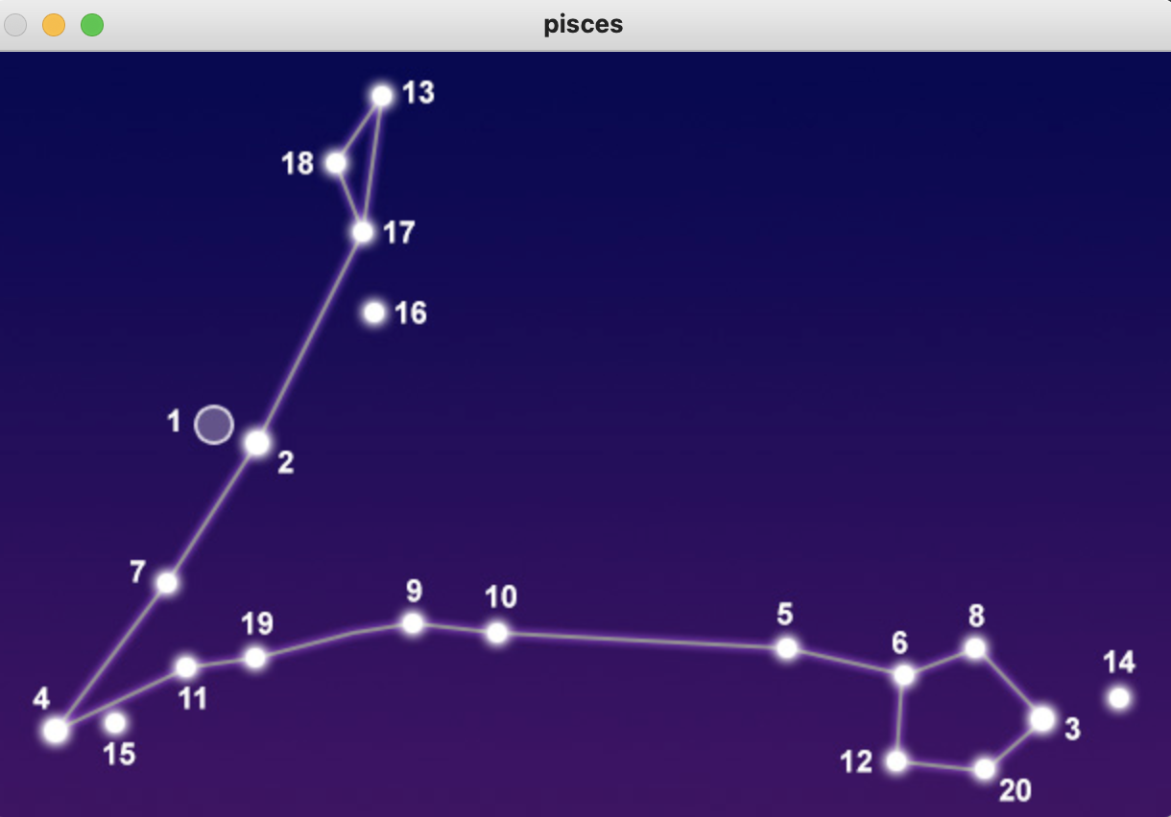
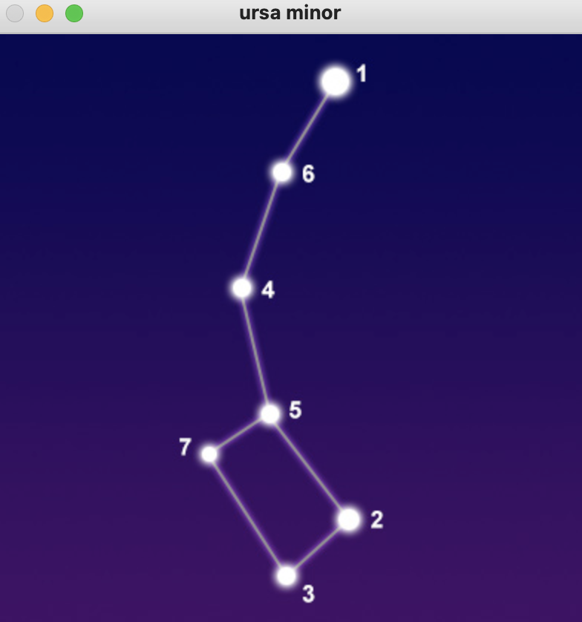
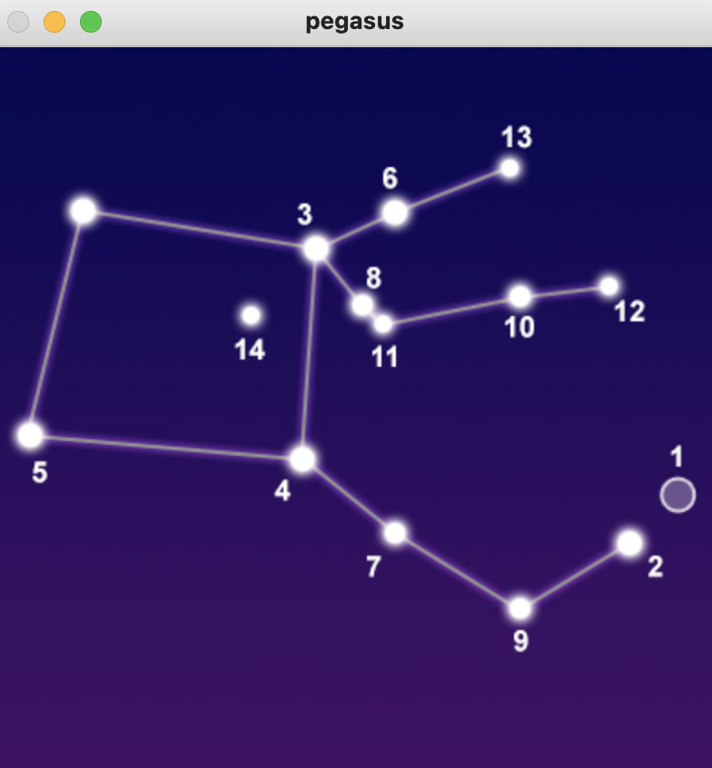
Everything Combined

Slide 24
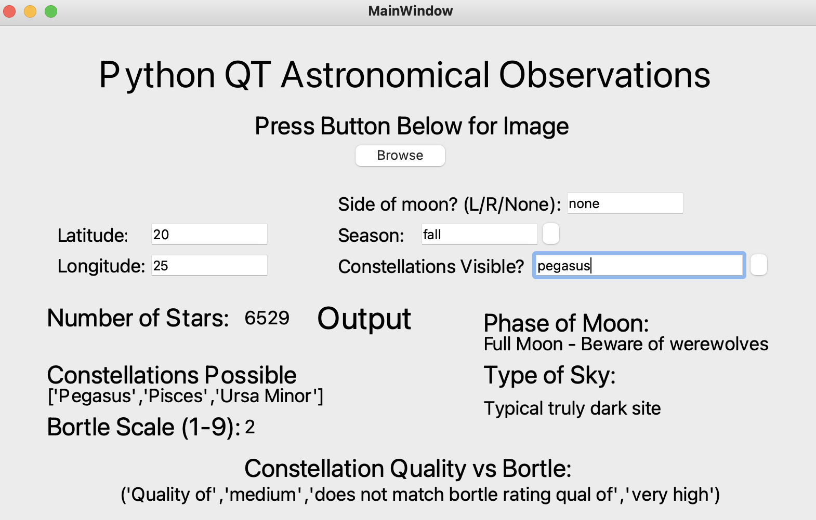
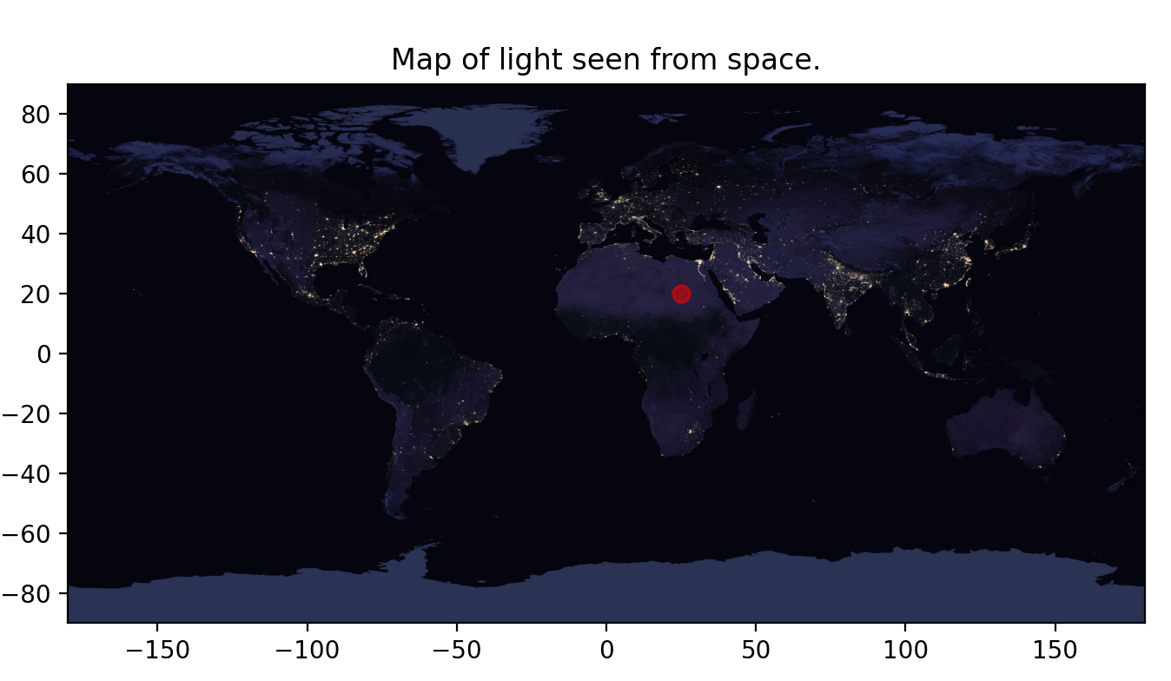
Everything Combined

Slide 25
References
https://www.sciencea-z.com/science/resource/SL_Gr_5_Earth,_Sun,_and_Stars_L5_all_printable_resources.pdf
https://www.windows2universe.org/the_universe/Constellations/south_constellations.html
https://www.astronomytrek.com/star-constellations-brightest-stars/
https://grove.ccsd59.org/wp-content/uploads/sites/10/2015/10/2.1a-How-The-Moon-Phases-Workpdf.pdf
https://viirsland.gsfc.nasa.gov/Products/NASA/BlackMarble.html
https://www.almanac.com/astronomy/moon/calendar

